Slide 1
Hillier Building Applications for Office 365 and SharePoint with Angular 2 and ASP.NET 5

Slide 2








www.itunity.com/users/scot-hillier
www.criticalpathtraining.com
scot@scothillier.net
@ScotHillier
www.microsoftvirtualacademy.com/Studies/SearchResult.aspx?q=hillier
channel9.msdn.com/Search?term=hillier#ch9Search
www.pluralsight.com/search/?searchTerm=hillier

Slide 3
Agenda
Enterprise JavaScript
Classes and Modules
TypeScript
Angular 2 Framework
Fundamentals
Observables
Security and Permissions
Azure Active Directory
OpenID Connect
OAuth

Slide 4
Enterprise JavaScript
Classes and Modules

Slide 5
ECMAScript 2015
Compatibility
Varying levels of support
https://kangax.github.io/compat-table/es6/
Features
http://es6-features.org
arrows | classes | enhanced object Literals | template literals
destructuring | default, rest, spread | let, const | iterators
generators | unicode | modules, loaders | map, set
proxies | symbols | built-ins | promises
object APIs | literals | reflection | tail calls

Slide 6
Classes
class person {
constructor(firstName, lastName) {
this.firstName = firstName;
this.lastName = lastName;
}
speak() {
return `My name is ${this.firstName} ${this.lastName}.`;
}
}
var p = new person('Scot', 'Hillier');
alert(p.speak());

Slide 7
Inheritance
class customer extends person {
constructor(firstName, lastName, title, company, email) {
super(firstName, lastName)
this.title = title;
this.company = company;
this.email = email;
}
talk() {
return `${super.speak()} I work for ${this.company}.`;
}
}
var c = new customer('Scot', 'Hillier', 'MVP',
'IT Unity', 'scot@scothillier.net');
alert(c.talk());

Slide 8
Modules
Internal
Used to encapsulate code
Prevents global namespace pollution
Loaded through a Script tag
External
Small units of independent, reusable code
Supports the pattern of “component” development
Loaded using an async module loader component

Slide 9
Using the Revealing Module Pattern
Internal Module
//namespace
var Wingtip = window.Wingtip || {};
Wingtip.Customer = function () {
//private members
var name,
setname = function (n) { name = n; },
getname = function () { return name; },
talk = function () { alert("My name is " + name); };
//public interface
return {
set_name: setname,
get_name: getname,
speak: talk
}
}();
Wingtip.Customer.speak();

Slide 10
External Modules
Modules are stored in files
1:1 mapping between a file and a module
“barrels” are files referencing multiple modules
Follow various patterns to support dynamic loading
Current ECMAScript 5 support
CommonJS format used with node.js server code
AMD format with require.js client code
UMD format is compatible with AMD, CommonJS and no loader at all
JavaScript Loader standard
Will eventually use a built-in System.register format
Use today through a polyfill

Slide 11
ES6 Declarative module usage
//requires a transpiler or polyfill today
//person.js
export class Person {
constructor(firstName, lastName) {
this.firstName = firstName;
this.lastName = lastName;
}
}
//app.js
import {Person} from 'person';
let p = new Person();

Slide 12
ES6 dynamic module loading
//requires a transpiler or polyfill today
//person.js
export class Person {
constructor(firstName, lastName) {
this.firstName = firstName;
this.lastName = lastName;
}
}
//app.js
System.import('person').then(Person => {
let p = new Person();
}).catch(error => {
alert(error);
});

Slide 13
AMD modules with require.js
//index.html
<script src="/Scripts/require.js" data-main="/Scripts/app"></script>
//app.js
define(["require", "exports", "customer"], function (customer) {
alert(customer.speak());
});
//customer.js
define(["require", "exports"], function (require, exports) {
var Customer = (function () {
function Customer(fn, ln) {
this.firstName = fn;
this.lastName = ln;
}
Customer.prototype.speak = function () {
return "My name is " + this.firstName + " " + this.lastName;
};
return Customer;
})();
exports.Customer = Customer;
});

Slide 14
ES6 module loader polyfill
<script src="traceur.js"></script>
<script src="es6-module-loader-dev.js"></script>
<!-- type="module" invokes the Google traceur transpiler on that code -->
<!-- System.import support is provided by the es6-module-loader -->
<script type="module">
System.import('app/module1.js').then(function (module1) {
let p = module1.Person('Scot', 'Hillier');
alert(p.speak());
}).catch(function (err) {
alert(err);
});
</script>

Slide 15
Register modules with system.js
<script src="system.js"></script>
<!–- built on top of the es6-module-loader polyfill -->
<!–- loads any module format, invokes transpiler if necessary -->
<script>
System.config({
packages: {
'app': {
format: 'register',
defaultExtension: 'js'
}
}
});
System.import('app/myModule')
.then(null, console.error.bind(console));
</script>

Slide 16
DEMO
Classes and Modules

Slide 17
Enterprise JavaScript
TypeScript

Slide 18
Introduction to TypeScript
Typed superset that transpiles to plain JavaScript
You write .ts files and it compiles to .js files
Cross-browser compatible
Integrated into Visual Studio 2015
Compilation
Intellisense
Key Features
Static typing
Classes, constructors, properties, methods
Modules
Interfaces

Slide 19
Static Typing
private getQueryStringParameter(p: string): string { ... };
scope
Input type
Return type
private displayName: string = "Scot";
Supported Types
boolean
number
string
Array<T>
enum
any
void
scope
type

Slide 20
Classes
class Welcome {
//private members
private displayName: string = "Scot Hillier";
private pictureUrl: string = "/images/sh.jpg";
//public methods
public get_viewModel() {
return {
"pictureUrl": this.pictureUrl,
"displayName": this.displayName
};
}
}

Slide 21
Interfaces
interface WelcomeData {
pictureUrl: string;
displayName: string;
}
class Welcome {
public get_viewModel(): WelcomeData {
return {
"pictureUrl": this.pictureUrl,
"displayName": this.displayName
};
}
}
Define Interface
Implement Interface

Slide 22
Internal Modules
//define module
module Wingtip {
export class Welcome {
private displayName: string = "Scot Hillier";
private pictureUrl: string = "/images/sh.jpg";
public get_viewModel() {
return {
"pictureUrl": this.pictureUrl,
"displayName": this.displayName
};
}
}
}
//use module
var vm = new Wingtip.Welcome();

Slide 23
External Modules
//wingtip.ts
export module Wingtip {
export class Welcome {
private displayName: string = "Scot Hillier";
private pictureUrl: string = "/images/sh.jpg";
public get_viewModel() {
return {
"pictureUrl": this.pictureUrl,
"displayName": this.displayName
};
}
}
}
//app.ts
import {Wingtip} from 'wingtip'
var vm = new Wingtip.Welcome();

Slide 24
Type Definition Files
Supports the use of external libraries
Provides intellisense in TypeScript environment
Takes the form of a *.d.ts file
Available “typings” NPM package
npm install typings –global
typings install sharepoint –ambient --save

Slide 25
DEMO
TypeScript Modules

Slide 26
Angular 2 Framework
Fundamentals

Slide 27
Introducing Angular 2
Description
Single-Page Application (SPA) Framework
Implements MV* (pronounced M-V-star) Pattern
Why Angular
True framework instead of patchwork of libraries
Strong separation of concerns
Why Angular 2
Significant improvements in speed
Supports latest JavaScript innovations like components, modules
Better mobile support

Slide 28
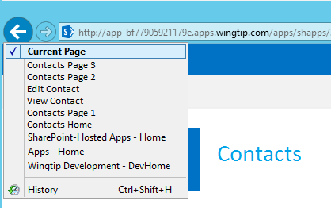
Single-Page Applications
App has one page
Different views are loaded dynamically
Routes are used to simulate pages
History list reflects route navigation
Id
First Name
Last Name
Id
1
First Name
Scot
Contacts.html
Last Name
Hillier

Slide 29
MV* with Angular 2
View
Component
Data
Model

Slide 30
Angular Building Blocks
Modules and Barrels
Components and Directives
Templates and Binding
Services and Dependency Injection

Slide 31
Modules and Barrels
//module
export class Welcome {
public static getMessage() {
return 'Hello, World!';
}
}
custom module
import module
//component
import {Welcome} from './app.module'
import {Component} from 'angular2/core'
Import barrel

Slide 32
Components and Directives
import {Welcome} from './app.module'
import {Component} from 'angular2/core'
@Component({
selector: 'app-main',
template: `<h1>${Welcome.getMessage()}</h1>`
})
export class AppComponent { }
Component associates HTML template with CSS selector
<tr *ngFor="#item of items">
<td>{{item.Title}}</td>
<td>{{item.Body}}</td>
</tr>
Structural directive adds elements to DOM
Attribute directive alters existing elements
<div [(ngModel)]="welcomeMessage"></div>

Slide 33
Important Built-in Directives
ngModel: binds component data to view
ngFor: for-each loop data binding
ngIf: conditional data binding
ngSwitch, ngSwitchWhen: switch-case data binding
ngStyle, ngClass: styles an HTML element

Slide 34
DEMO
Hello, Angular 2

Slide 35
Templates and Binding
<!-- interpolation -->
<div>{{welcomeMessage}}</div>
<!-- property binding -->
<button [disabled]="isWorking"></button>
<!-- event binding -->
<button (click)="buttonClicked()"></button>
<!-- two-way binding -->
<input [(ngModel)]="firstName"/>
<!-- directives -->
<div [ngClass]="'byline'">{{author}}</div>
<my-directive [myProperty]="'an expression'"></my-directive>
<!-- attribute binding -->
<button [attr.aria-label]="actionName">Aria</button>

Slide 36
Services and Dependency Injection
export class SimpleService {
constructor() { }
getMessage() { return "Hi!"; }
}
Create the service
import {Component} from 'angular2/core'
import {SimpleService} from './simple.service'
@Component({
templateUrl: '/app/templates/simple.html',
providers: [SimpleService]
})
export class SimpleComponent {
welcomeMessage: string;
constructor(simpleService: SimpleService) {
this.welcomeMessage = simpleService.getMessage();
}}
Inject the service

Slide 37
DEMO
Services and Dependency Injection

Slide 38
Angular 2 Framework
Observables

Slide 39
Observables
Support asynchronous operations
Define callback function with observer
Client subscribe to the Observable
Supports sequential and parallel operations
Angular Http returns an Observable
Interpolations can be assigned Observables

Slide 40
Custom Service
import {Observable} from 'rxjs/Observable'
import {Observer} from 'rxjs/Observer'
export class MyService {
constructor() {}
getData(): Observable<string> {
return Observable.create(observer => {
try {
observer.next('emit a value');
observer.complete();
}
catch (err) { observer.error(err); }
return function () {
//disposal function
}
});
}

Slide 41
Custom Consumer
@Component({
providers: [MyService]
})
export class MyComponent {
myService: MyService;
subscription: Subscription<string>;
constructor(ms: MyService) { this.myService = ms; }
subscribeToService() {
this.subscription = this.myService.getData().subscribe(
data => { console.log(data); },
err => { console.error(err); },
() => { console.info('completed'); }
);
}
cancelSubscription() { this.subscription.unsubscribe(); }
}

Slide 42
HTTP Service
import {Injectable} from 'angular2/core'
import {Http, Headers, Response} from 'angular2/http'
@Injectable()
export class ProductService {
httpService: Http;
constructor(http: Http) {
this.httpService = http;
}
getProducts(): Observable<any> {
return this.httpService.get("http://services.odata.org/.../Northwind.svc/Products", {
headers: new Headers({
"Accept": "application/json"
})
});
}
}

Slide 43
DEMO
Observables

Slide 44
Security and Permissions
Azure Active Directory

Slide 45
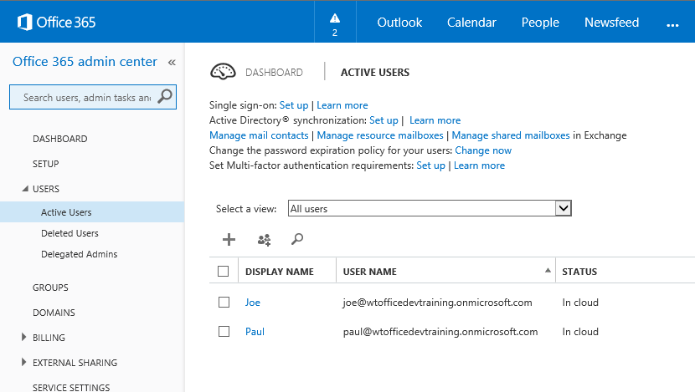
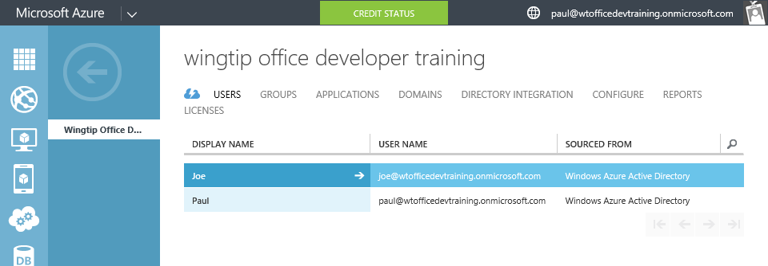
Azure Active Directory (Azure AD)
Included in Office 365 Subscription
Users & Groups managed in Office 365 Portal
Changes persisted in Azure AD

Slide 46
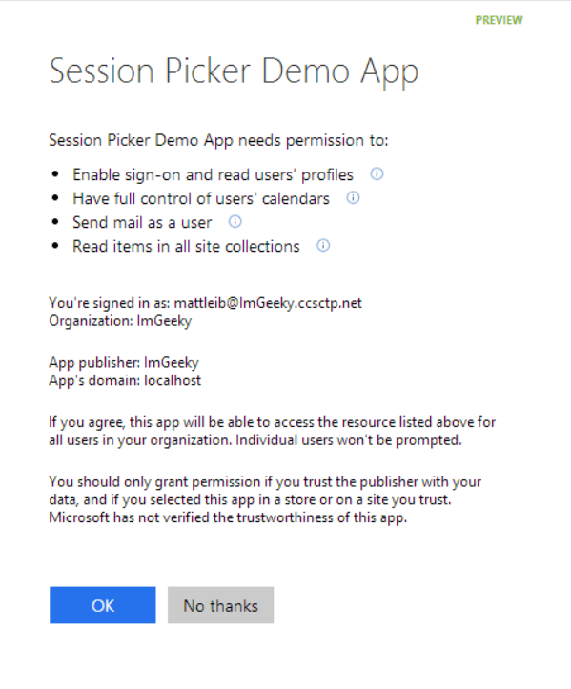
OAuth and OpenID Connect
Single auth flow
Azure AD Graph, Exchange, SharePoint
Device apps and web sites
Admin and end-user consent
OAuth 2.0
No capturing user credentials
Long-term access through refresh tokens
OpenID Connect
Extension of OAuth 2.0 to support authentication

Slide 47
What is OAuth 2.0?
Simple mechanism to grant a third party access to a user’s resources without sharing the user’s password (a.k.a, “delegated access”).
Cross platform app authorization
Internet Standard supported by Azure, Facebook, Google, Twitter, and more

Slide 48
What is OpenID Connect?
Authentication mechanism built on top of OAuth 2.0
Evolved because developers were already using OAuth 2.0 for authentication
Now the primary mechanism for web application authentication

Slide 49
Application Registration
Required to use OAuth and OpenID Connect
Web Application and/or WebAPI
Native Client
Application Types
Custom developed
Third-party, published in the gallery
Office Graph, SharePoint, Exchange
Thousands of others

Slide 50
DEMO
Registering an Application

Slide 51
Security and Permissions
OpenID Connect

Slide 52
OpenID Connect Actors
End User: person using the application
Client: application authenticating a user
Authorization Server: server issuing tokens

Slide 53
Authentication Request
Authorization endpoint
https://login.microsoft.com/{tid}/oauth2/authorize
Parameters
client_id: application identifier from AAD
redirect_uri: the URL where the re
response_type: id_token, code, token
response_mode: fragment, query, form_post
scope: openid, profile, email, address, phone
state: remember any information app needs back and prevent CSRF
nonce: value used to verify that the token hasn’t been altered

Slide 54


Web Application
(Client)
User accesses
application
End User
Azure Active Directory
(Authorization Server)

Slide 55
Web Application
(Client)
User is redirected to
The Authorization Server endpoint
and supplies appropriate
Authentication parameters
End User
Azure Active Directory
(Authorization Server)

Slide 56
Web Application
(Client)
Authorization Server issues an
ID token and redirects user
Back to the application
Note: could be a POST or GET
Depending on parameters
End User
Azure Active Directory
(Authorization Server)

Slide 57
Web Application
(Client)
Application examines the token,
validates using the nonce,
and establishes a session
End User
Azure Active Directory
(Authorization Server)

Slide 58
DEMO
OpenID Connect

Slide 59
Security and Permissions
OAuth

Slide 60
OAuth 2.0 Actors
Client: application requesting access to a user’s resources
Resource Owner: the user who can grant rights to the application
Resource Server: the server hosting the protected resources and exposing a web-based API
Authorization Server – server issuing tokens

Slide 61
OAuth 2.0 Tokens
Authorization Code
A code that can be used to obtain an access token.
Access Token
A token passed to the Resource Server authorizing the Client to access resources.
Refresh Token
A token used to get an Access Token from the Authorization Server.

Slide 62

Azure Web Site
(Client)
User accesses
application
End User
(Resource Owner)
Azure Active Directory
(Authorization Server)
SharePoint Online
(Resource Server)

Slide 63
Azure Web Site
(Client)
End User
(Resource Owner)
User redirected to AAD
For sign in and consent
Azure Active Directory
(Authorization Server)
SharePoint Online
(Resource Server)

Slide 64
Azure Web Site
(Client)
End User
(Resource Owner)
Authorization Server issues
authorization code
and redirects to client
Azure Active Directory
(Authorization Server)
SharePoint Online
(Resource Server)

Slide 65
Azure Web Site
(Client)
Client uses code and secret
To request an access token
End User
(Resource Owner)
Azure Active Directory
(Authorization Server)
SharePoint Online
(Resource Server)

Slide 66
Azure Web Site
(Client)
Access token returned
and cached in web storage
End User
(Resource Owner)
Azure Active Directory
(Authorization Server)
SharePoint Online
(Resource Server)

Slide 67
Azure Web Site
(Client)
End User
(Resource Owner)
Access token attached
and call made
Azure Active Directory
(Authorization Server)
SharePoint Online
(Resource Server)

Slide 68
Azure Web Site
(Client)
End User
(Resource Owner)
Data returns
Azure Active Directory
(Authorization Server)
SharePoint Online
(Resource Server)

Slide 69
Implicit Flow
Retrieve configuration information
This information is set up in the initialization code for the app
Create request URL for an ID token
Sends only the Client ID and asks to authenticate the user
User signs in
May also need to consent
Access token is returned
Returned as a # fragment for security
Access token is cached in web storage

Slide 70
Introducing ADAL JS
JavaScript library specifically for SPAs
Uses OAuth2 Implicit flow
Establishes an authorization context
Manages access and refresh tokens

Slide 71
DEMO
Implicit Flow

Slide 72
Summary
Enterprise JavaScript
Classes and Modules
TypeScript
Angular 2 Framework
Fundamentals
Observables
Security and Permissions
Azure Active Directory
OpenID Connect
OAuth

